Slide 1

Learn programming with
KELVIN
+6281219644314
kelvindsmn@gmail.com

Slide 2

MATERIAL
In this course we will learn about the following concepts :
Conditional
Debugging

Slide 3
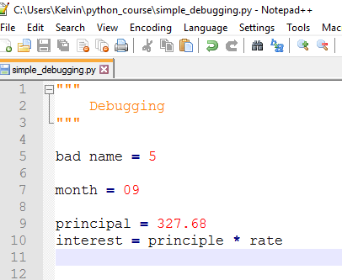
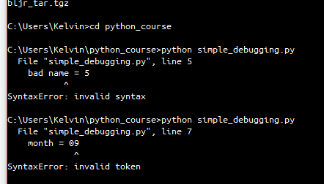
DEBUGGING

Slide 4
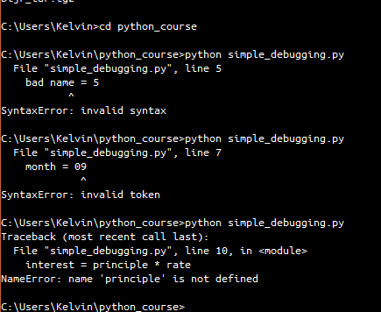
DEBUGGING

Slide 5
CONDITIONAL
Boolean Expression
Logical Operator
Boolean Expression is an expression that is either True or False
Logical Operator is ( = , < , > )

Slide 6
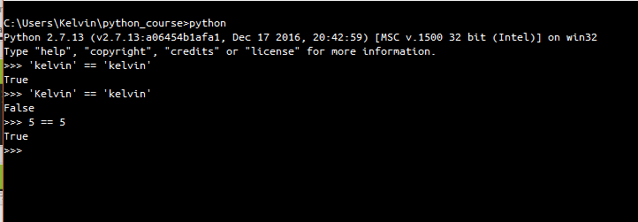
Boolean
the == operator is compares two operand and produces True if they are same and False otherwise

Slide 7
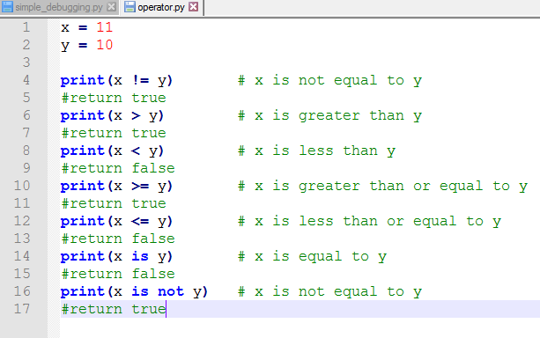
COMPARISON OPERATOR

Slide 8
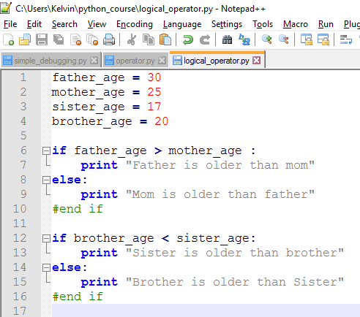
LOGICAL OPERATOR

Slide 9
BMI CALCULATOR
Metric BMI Formula
BMI = weight (kg) ÷ height² (m²)
Using the metric BMI formula above, create a program that takes 2 input (height, weight) , calculate the BMI and then print which category that user belongs to based from BMI
CATEGORY
Between 16 and 18.5 Underweight
Between 18.5 and 25 Normal (healthy weight)
Between 25 and 30 Overweight

